Slide 1

R-ODAF – Omics Data Analyses Framework for Regulatory Application
Marcha Verheijen &
Florian Caiment
Toxicogenomics
Maastricht University

Slide 2
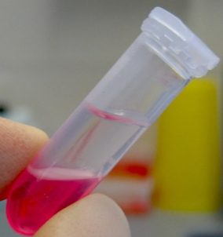
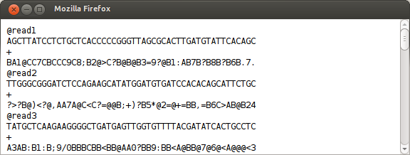
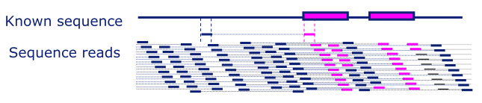
RNA-Sequencing
Gene_id Sample_1 Sample_2 Sample_3 Sample_4
ENSG00000000003 639 304 616 324
ENSG00000000005 2287 1071 1906 729
ENSG00000000419 534 58 253 298
ENSG00000000457 390 301 29 174
… … … … …

Slide 3
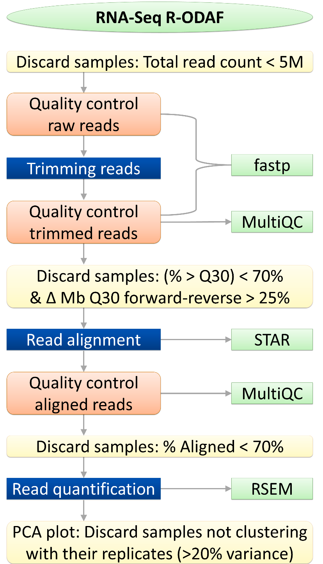
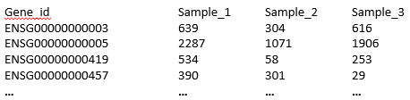
R-ODAF RNA-Seq
QC /
Mapping /
Quantification pipeline

Slide 4
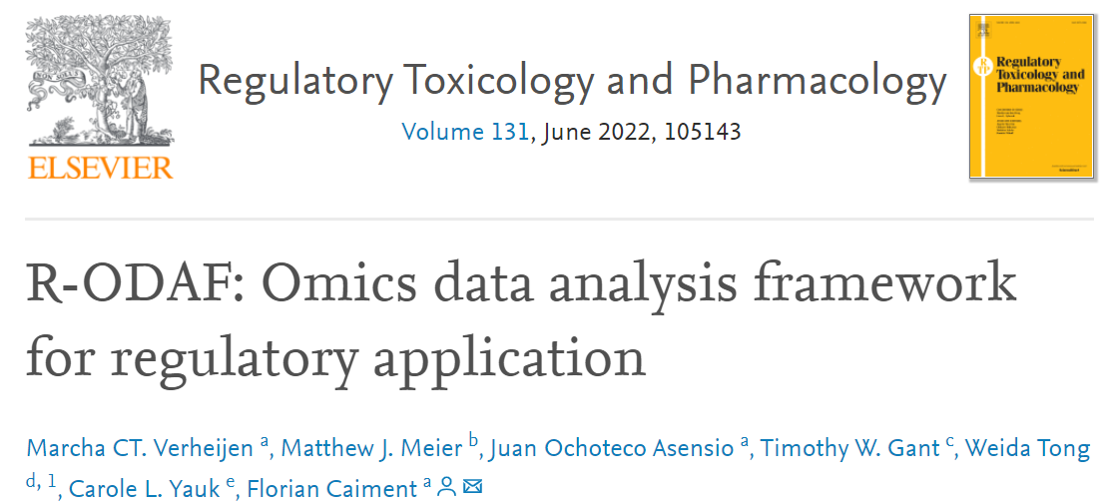
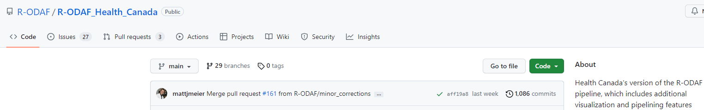
Publication
The R-ODAF itself is available on GitHub here:
https://github.com/R-ODAF/Main
Include a Docker environment for RNA-Sequencing and the script for the DEGs

Slide 5
Environment for running the R-ODAF pipeline
The R-ODAF is made
For a linux environment
To run on a powerfull computer or server environment
To run the tutorial on a normal laptop:
We supplied a virtual linux machine
Shrunk the sample data
Use a part of the reference genome (only Chr 1)

Slide 6
Step 1: Open the virtual machine

Slide 7
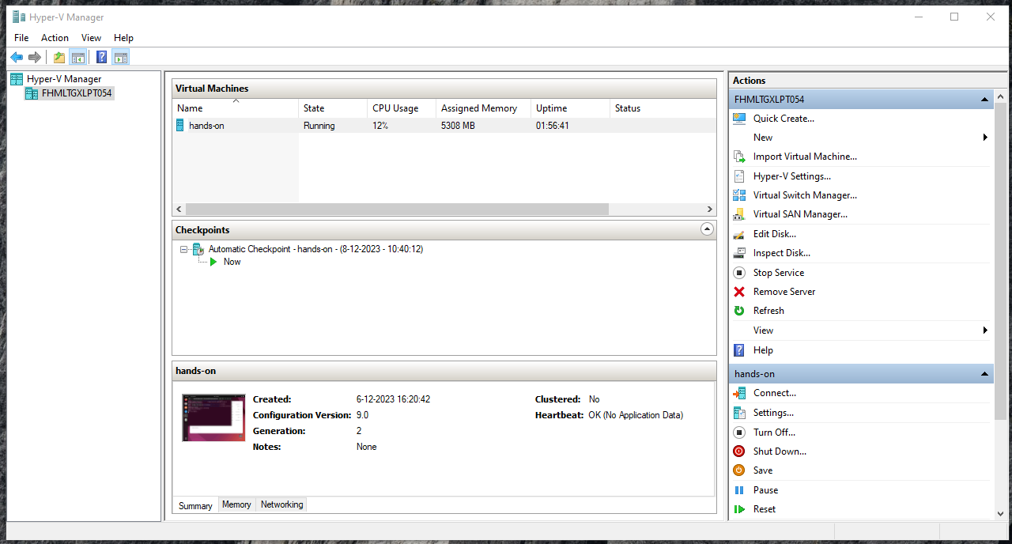
Correct installed VM

Slide 8
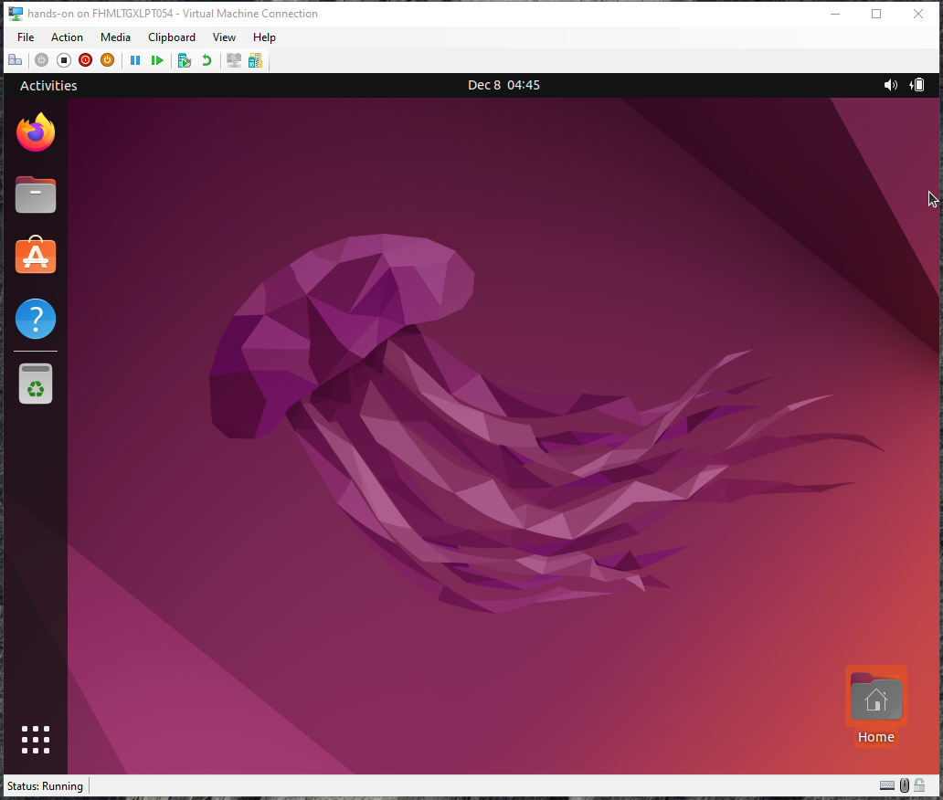
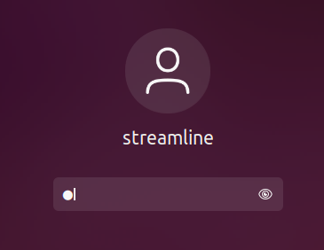
The Virtual Machine
Password = 12345

Slide 9
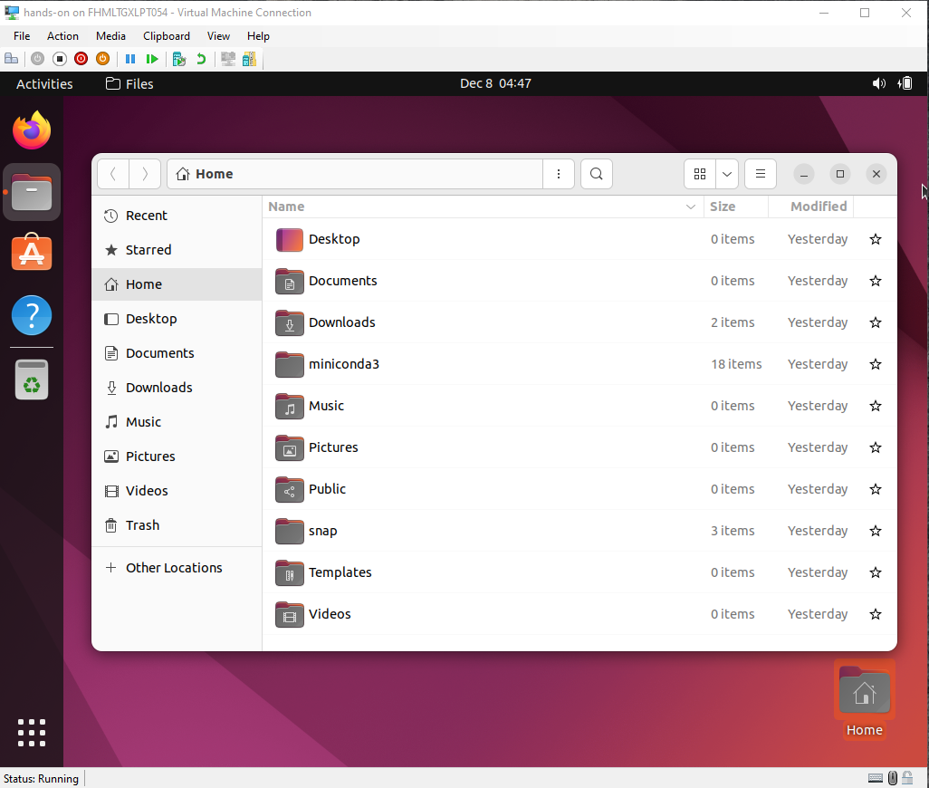
Tutorial materials
Location:
- Downloads/
- R-ODAFtutorial_Chr1/

Slide 10
Step 2: Prepare the R-ODAF script

Slide 11
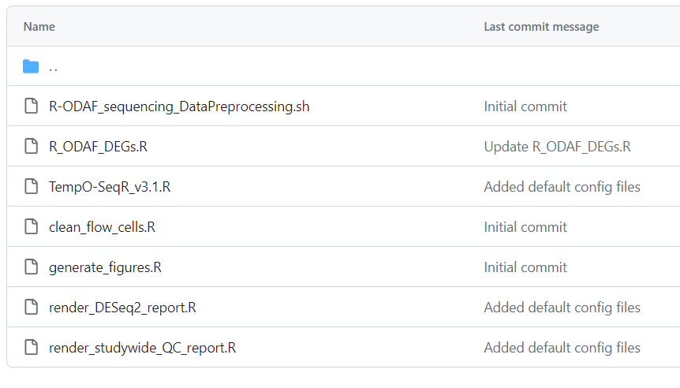
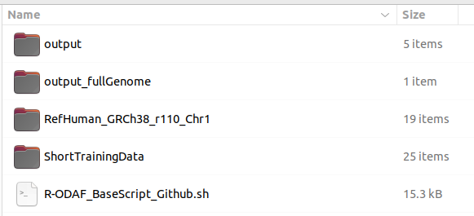
R-ODAF script
The script can be found on GitHub
https://github.com/R-ODAF/Main/tree/main/scripts
We already copied this to a document in your VM:
R-ODAF_BaseScript_Github.sh
The script needs to be adapted to
Your system
Your data

Slide 12
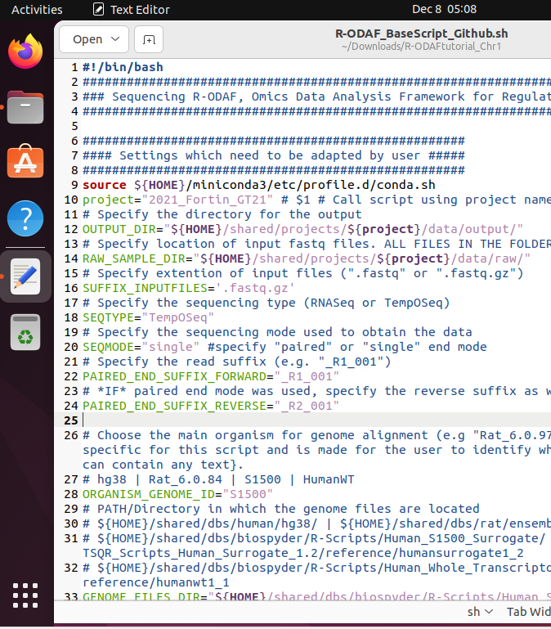
R-ODAF_BaseScript_Github.sh
The script is written in bash (basic linux language)
Contains many colors:
Blue: tekst comments. All text after #
Red: bash functions
Green: parameters of the script
Purple: strings = functional tekst → always between ‘ ’ or “ ”
Script contains many ${ParameterName}. This means that it calls a parameter that Has been specified before

Slide 13
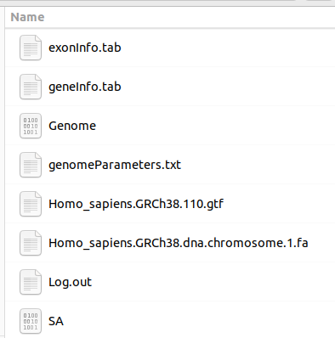
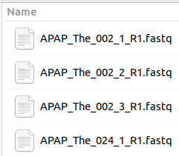
Adapting the script to your input
You will get a document guiding you (in the chat)
Information you need is found here
Genome data
Sample data

Slide 14
Adapting the script to your input
Scripts are very sensitive to:
Capitals
Spaces in wrong places
→ No space allowed beween PARAMETER=“text”
Missing signs such as “ ”
Mistakes will cause errors when running the script/line
(We might see that later)

Slide 15
Hands-on part1
Prepare the script
give the correct parameters
We will not run/excecute the lines yet
https://filesender.surf.nl/?s=download&token=a1169995-a0f1-49fd-9097-2a840c55f811

Slide 16
Review Hands-on part1
Prepare the script
→ give the correct parameters

Slide 17
Step 3: Run lines by copy pasting

Slide 18
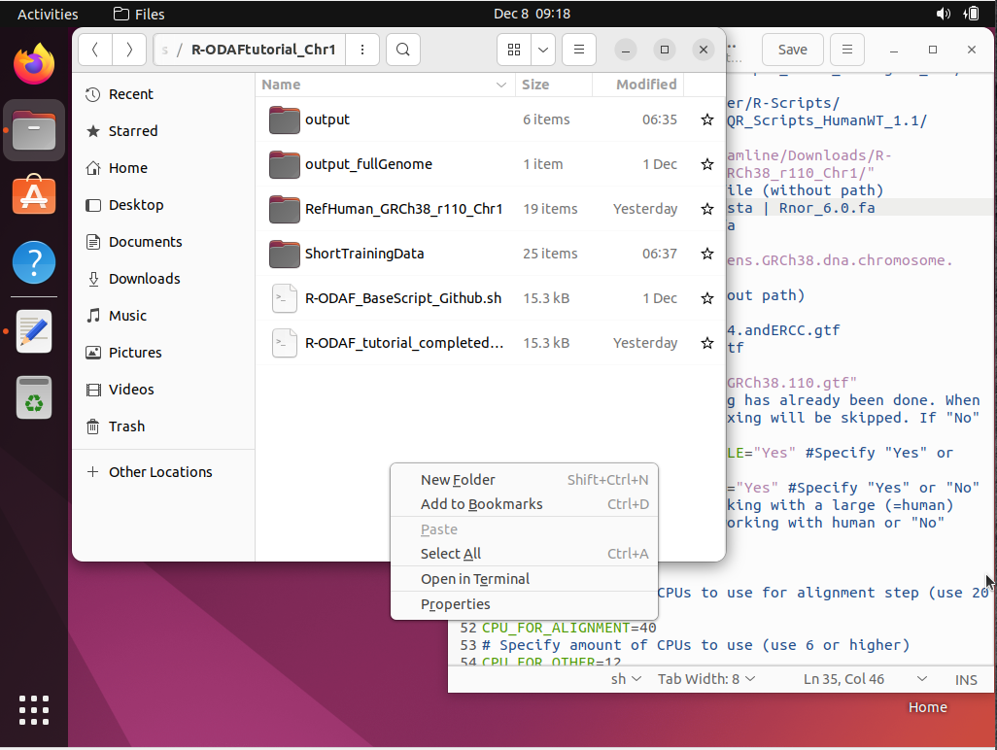
Open a terminal
In the explorer
On bottom white part
Right mouse click
Open in Terminal

Slide 19
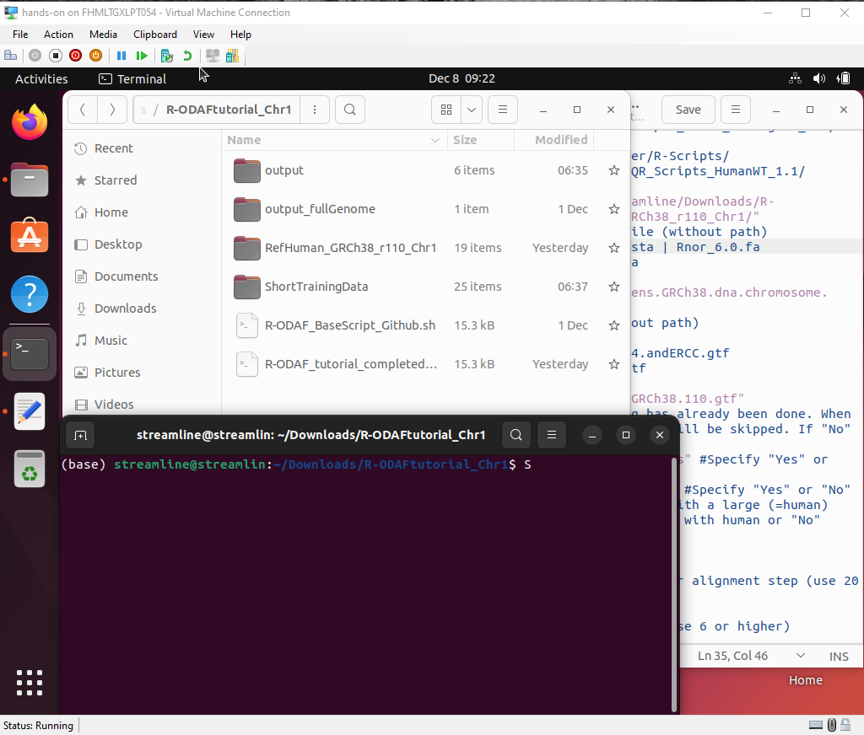
Navigating
Go to explorer
Explorer
Go to terminal
Script
Go to script
Terminal

Slide 20
Copy-paste lines
explorer
Explorer
Go to script
Select lines 1-57
Copy (ctrl+c)
Go to terminal
Paste (ctrl+SHIFT+v)
Press ENTER
terminal
Script
script
Terminal

Slide 21
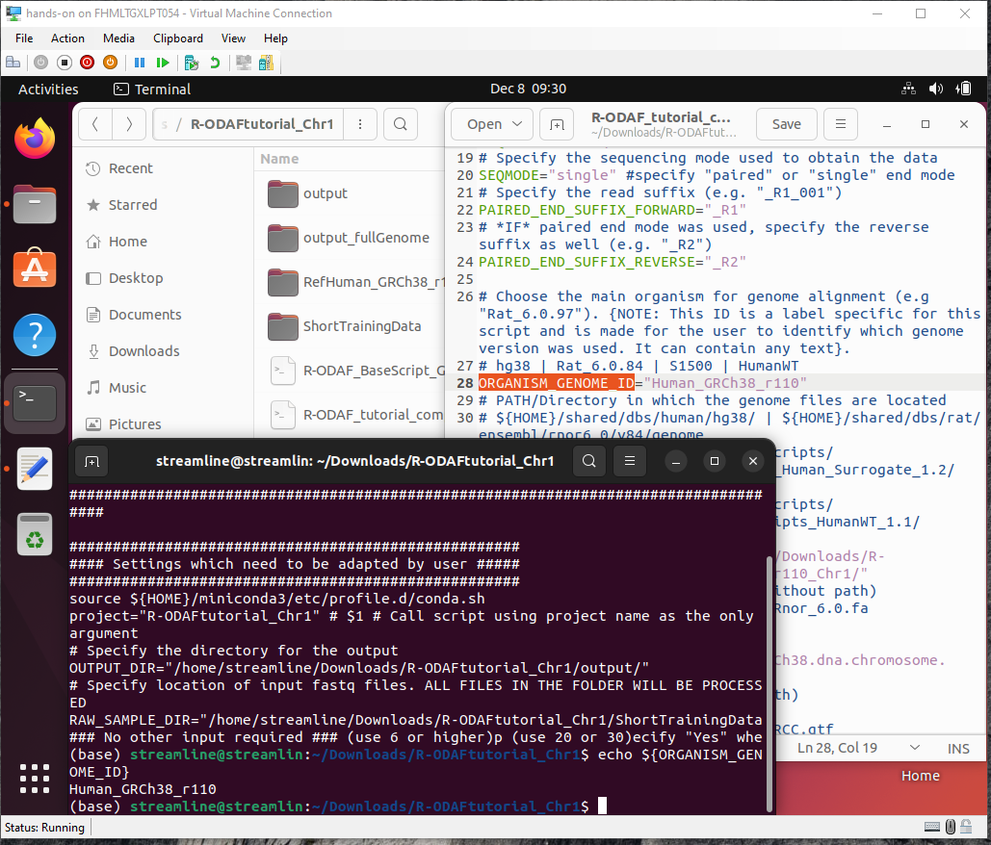
Check if it worked
To see if you did it correct:
Type in the terminal:
echo ${ParameterName}
E.g. echo ${ORGANISM_GENOME_ID}
After pressing enter, the input you gave should be visible in the terminal.

Slide 22
Hands-on part2
Run lines
https://filesender.surf.nl/?s=download&token=953286e2-6e25-414a-bc2e-acad9c660d37

Slide 23
Review Hands-on part2
Run lines

Slide 24
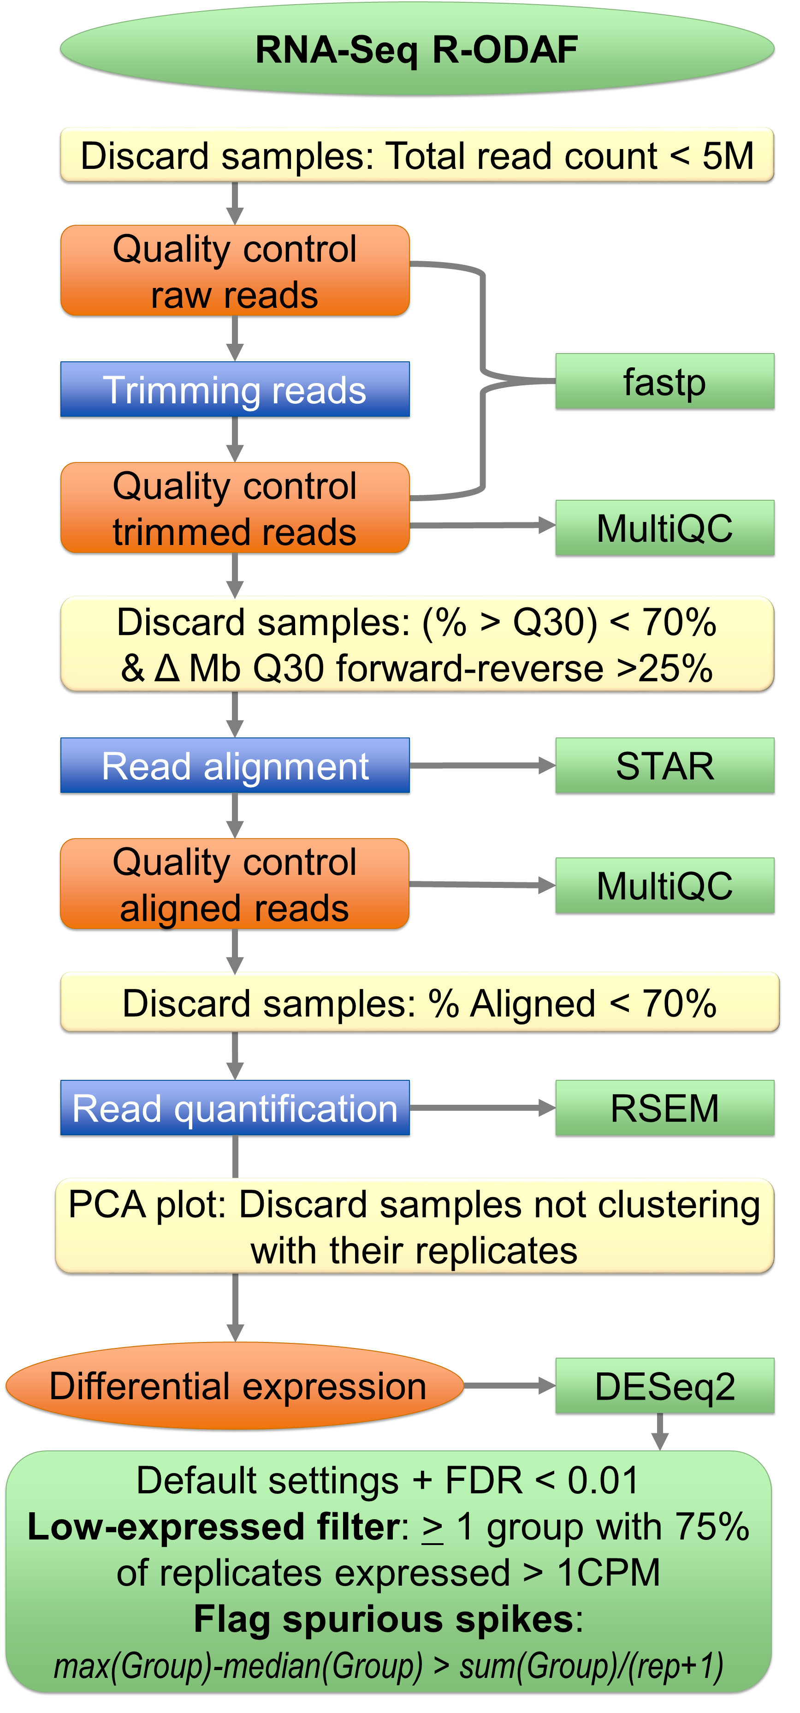
What did we do?
We now ran:
Setting of parameters
Creation of directories
Trimming of sequencing reads
The R-ODAF overview contains QC steps.
We will run these at the end

Slide 25
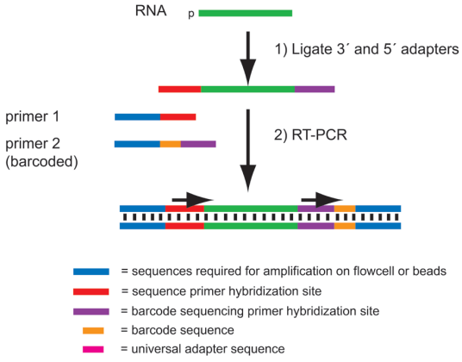

Trimming of reads

Slide 26
Step 4: Aligning reads to the reference genome Step5: Quantifying these reads

Slide 27
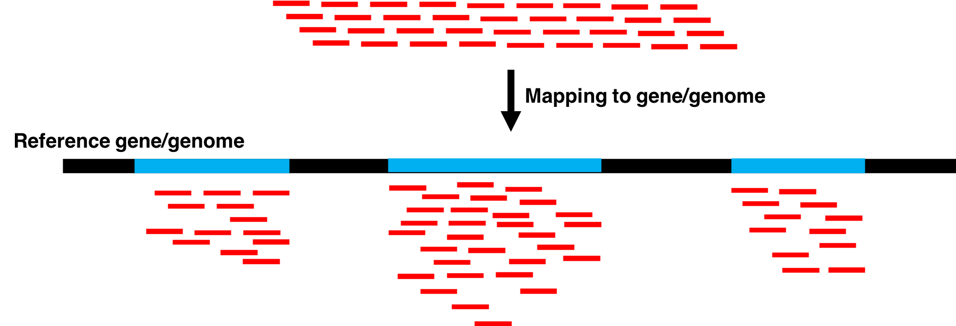
Mapping reads to the genome (STAR)

Slide 28
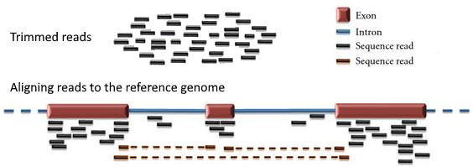
Quantifying reads (RSEM)

Slide 29
Hands-on part3
Run Alignment & quantification
Warning: output from quantification will be empty due to partial genome
https://filesender.surf.nl/?s=download&token=9e791e05-0aa2-43fb-951f-e38516a1b4ba

Slide 30
Step 6: Quality control & excluding samples

Slide 31
MultiQC
Is run at the end of the pipeline
Creates one QC document for all steps and samples
MultiQC does not work in the VM
Your tutorial files contains a folder “outpur_fullGenome”
This is output obtained from your sample files, but using the full genome reference

Slide 32
Hands-on part4
QC & sample exclusion
https://filesender.surf.nl/?s=download&token=a3efee13-1729-403d-a0bd-e06d386c0078

Slide 33
Review Hands-on part4
QC & sample exclusion

Slide 34
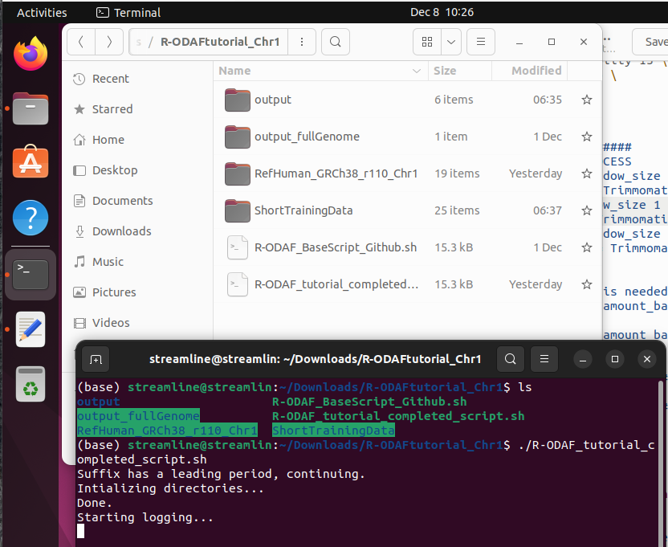
Running the wole script at once
When you will actually run the R-ODAF, you will not copy paste.
You will:
Adapt de script to your samples & system
Save the script
Run the whole script.

Slide 35
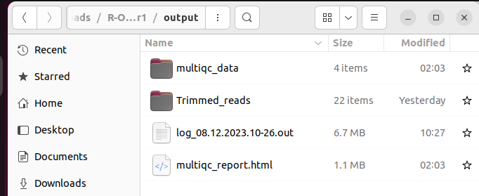
Running the wole script at once
Adapt de script to your samples & system
Save the script
Run the whole script.
Check the log file before QC

Slide 36
End of Hands-on session
We hope you learned a lot

